Slide 1

Task 1 Exploratory Data Analysis (ANZ Synthesized Transaction Data)
By: Mehul Varsha Singh
Email : mehulvarshasingh10@gmail.com
Github : https://github.com/githubmehul

Slide 2
Given :
This task is based on a synthesized transaction dataset containing 3 months worth of transactions for 100 hypothetical customers.
It contains purchases, recurring transactions, and salary transactions.
The dataset is designed to simulate realistic transaction behaviors that are observed in ANZ’s real transaction data.
Tools Used : Excel , Jupyter Notebook(Python) and Tableau

Slide 3







Summary Slide - 1
Basic Checks
# | Data Checks | Link To Slide
1. | Shape of Dataset , Columns Listed
2. | Check for Unique Customers
3. | Check for Unique Transactions
4. | Check if the Data is for 3 Months
5. | Check for Missing Data , Make Relevant Changes in Dataset
6. | Numeric and Categorical Descriptive Statistics

Slide 4










Summary Slide - 2
Data Insights
# | Source Data | Data Insights | Link To Slide
1. | Number of Transactions By Transaction Type | Mostly consists of Sales Payments. Seize Phone Banking Operations.
2. | Average Transaction Volume By Transaction Type | Pay/Salary has the largest transaction volume .
3. | Number of Transactions By Gender | More Male Customer Transactions than Female Customer Transactions
4. | Average Transaction Volume By Gender | Male Customers have a higher transaction volume than Female Customers
5. | Age of Customers | Majority of the Customers are in the range 20 – 25 Lacking in the middle-age and elderly customers
6. | Number of Transactions By State | NSW and VIC is where most transactions have taken place. Has strong foothold in larger states .Target medium sized states
7. | Average Transaction Volume By State | ACT has the highest Transaction Volume
8. | Number of Transactions Per Suburb | Melbourne and Sydney have the highest No of Transactions.

Slide 5










Summary Slide - 3
Data Insights
# | Source Data | Data Insights | Link To Slide
9. | Number of Transactions By Movement | Majority of the no of transactions of are debit transactions
10. | Average Transaction Volume By Movement | Average Transaction Amount for credit transactions are higher
11. | Average Transaction Amount For the Year 2018 | Average Amount For 2018 : 187.93 AUD
12. | Average Transaction Volume By Month | Average Transaction Volume is the Highest in Oct
13. | Number of Transactions Within the Week | Number of Transactions are Higher on Fri and Wed , the Lowest , on Monday and Tuesday
14. | Number of Transactions Per Transaction Type in a Week | No salaries were paid on Saturday and Sunday . Sales-POS Transactions are the least on Mon & Tues
15. | Average Transaction Volume Per Hour | Highest Transaction Volumes happen during the mid-day & late afternoon.
16. | Average Transaction Volume Per Hour By Transaction Type | Pay/Salary are the highest during the mid-day & late afternoon
17. | Distance Between the Customer and Merchant Location | For Customer ID CUS – 515066836 , the distance covered in QLD accounts for the greatest distance

Slide 6
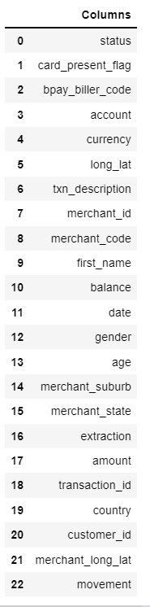
Basic Checks
Shape of Dataset : 12043 rows and 23 features
There are 12043 transactions for 100 customers(one bank account each) within the period of 3 months ( August , September and October) from 01/08/2018 – 31/10/2018.
Columns listed are :

Slide 7
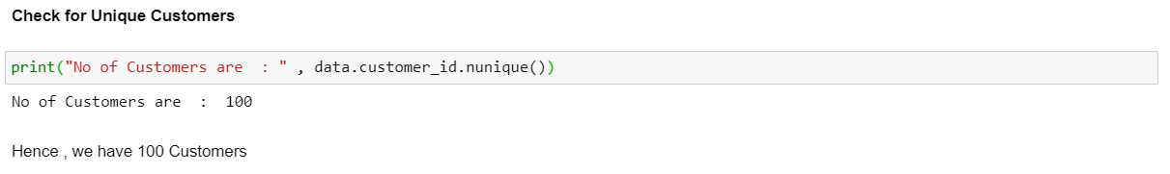
Basic Checks
Check for Unique Customers

Slide 8
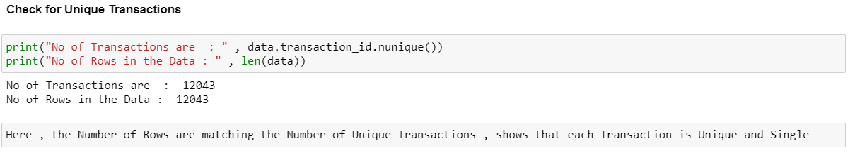
Basic Checks
2. Check for Unique Transactions

Slide 9
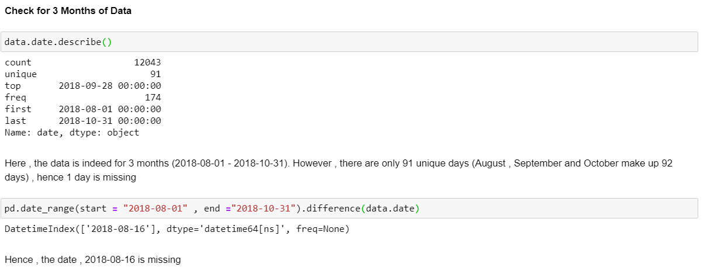
Basic Checks
3. Checked If the Data is Indeed for 3 Months

Slide 10
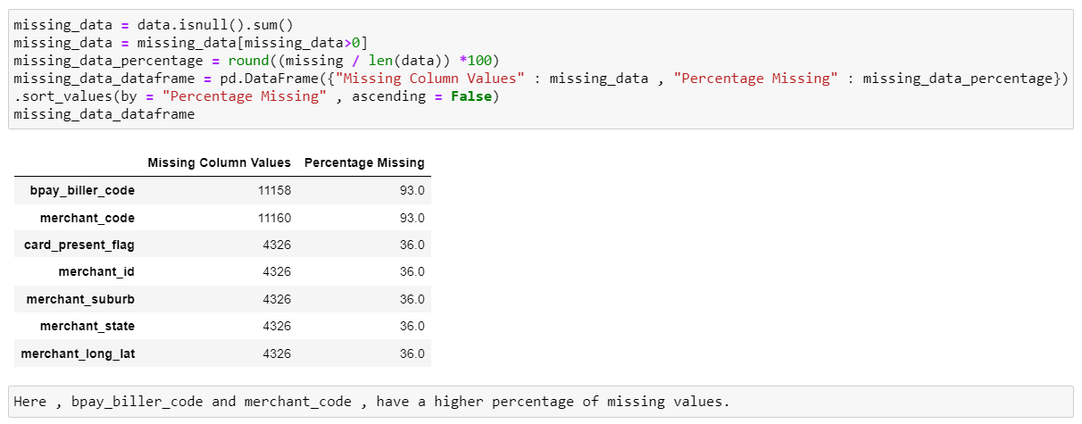
Basic Checks
4. Checked for Missing Values in the Data

Slide 11
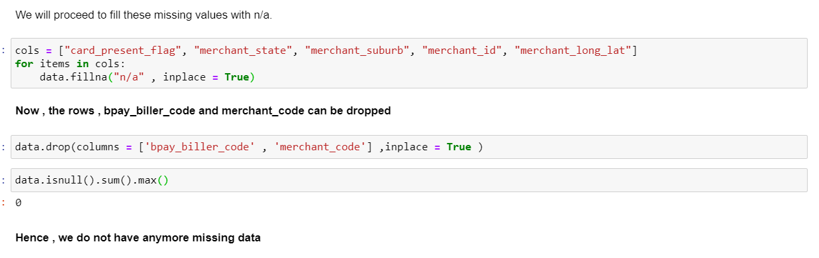
Basic Checks
4. Checked for Missing Values in the Data
Was curious as to why were there missing values for the columns other than bpay_biller_code and merchant_code ?
Realised that , those columns were empty , when they were mapped to non – purchase transactions(nature of payment.

Slide 12
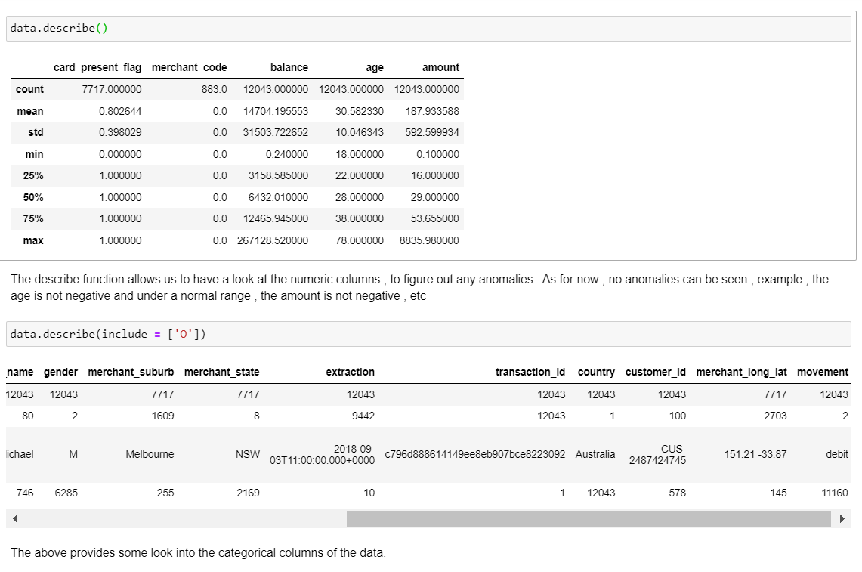
Basic Checks
Descriptive Statistics on Numeric and Categorical Columns

Slide 13
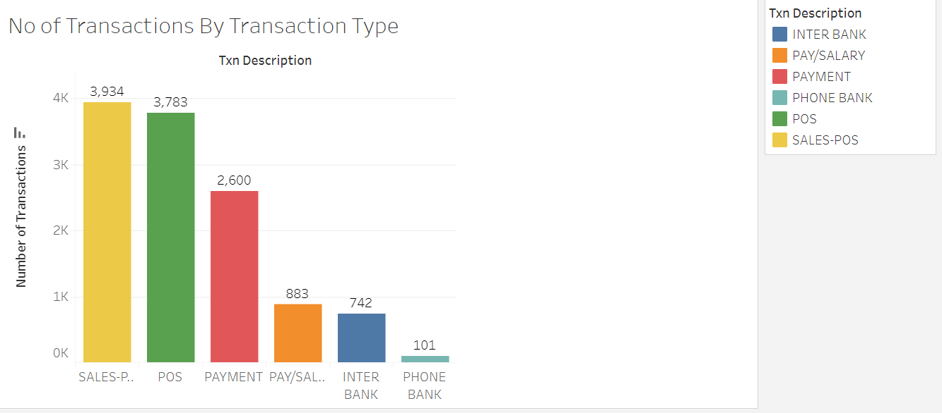
Data Insights
Insight About the Number of Transactions By Transaction Type:
These are the Number of Transactions made by the Transaction Description
We can see , that the Number Transactions mostly consists of Sales Payments.
AnZ Could Seize Phone Banking Operations because the Number of Transactions are the lowest in that category.

Slide 14
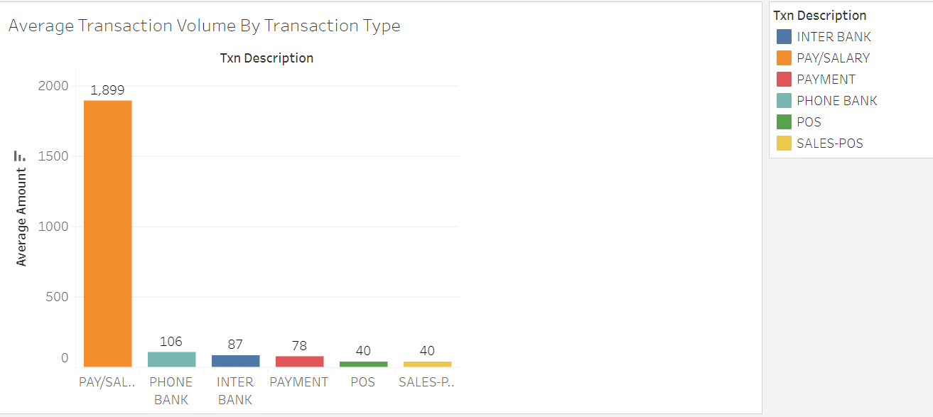
Data Insights
2. Insight About the Average Transaction Volume By Transaction Type:
These are the Average Transaction Volume made by the Transaction Description
We can see , that Pay/Salary has the largest transaction volume .

Slide 15
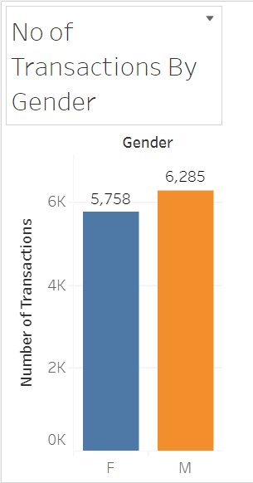
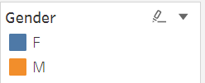
Data Insights
3. Insight About The Number of Transactions By Gender.
These are the Number of Transactions that are made by each Gender (Male and Female)
We can see that there are more Male Customer Transactions than Female Customer Transactions
Bank should come out with programs to onboard female clients.

Slide 16
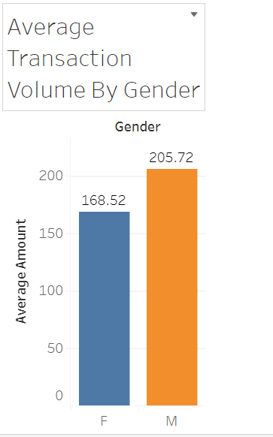
Data Insights
4. Insight About The Average Transaction Volume By Gender.
These are the Average Transaction Volume by each Gender (Male and Female)
We can see , Males have a higher transaction volume than females
Similarly , the Bank should come out with special programs to onboard female clients.

Slide 17
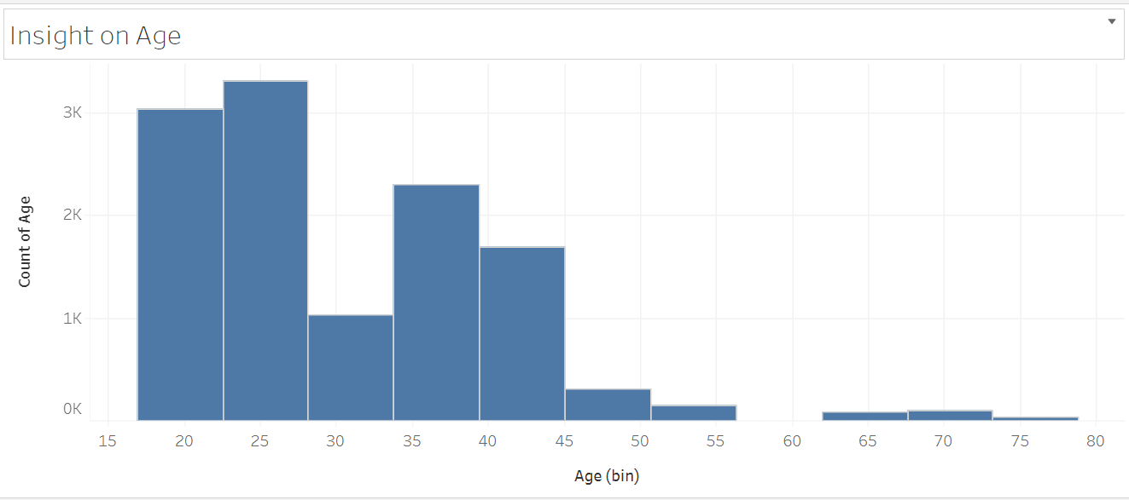
Data Insights
5. Insight About The Age of Customers
We can see , that Majority of the customers have the ages in the range 20 – 25
AnZ is popular among younger customers .
However , it is lacking severely in the middle-age and elderly customers , who usually have a higher spending and higher incomes

Slide 18
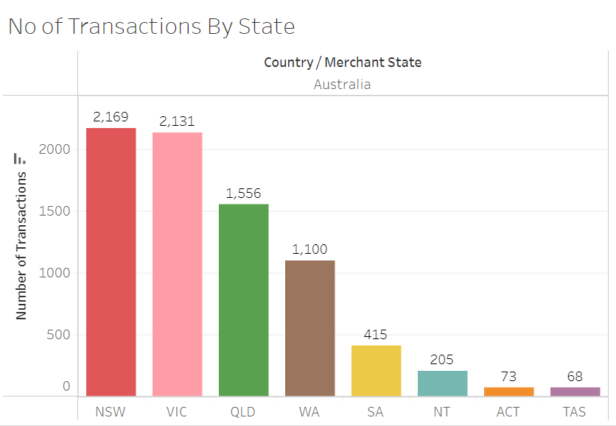
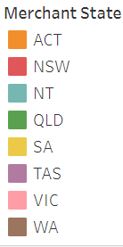
Data Insights
6. Insight About The Number of Transactions By State
These are the Number of Transactions By State
We can see , that NSW and VIC are the states where more transaction has taken place.
AnZ has a Strong foothold in larger states , especially those in the east side.
AnZ Should target states such as Western Australia.

Slide 19
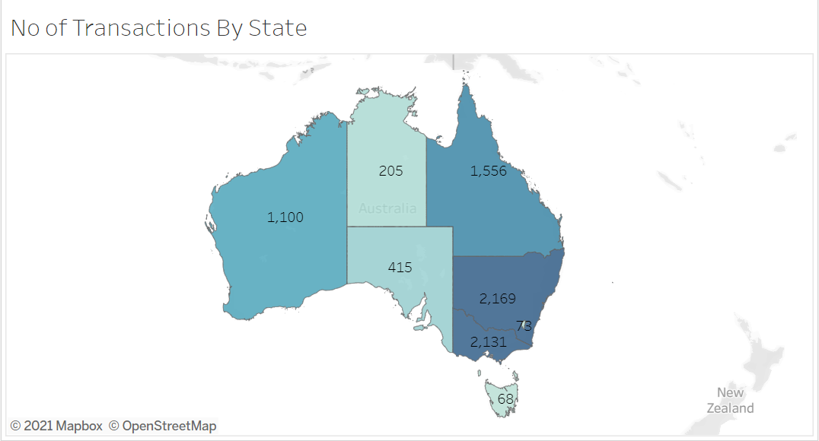
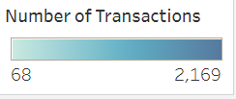
Data Insights
6. Insight About The Number of Transactions By State
Same Insight , shown in a Map Form

Slide 20
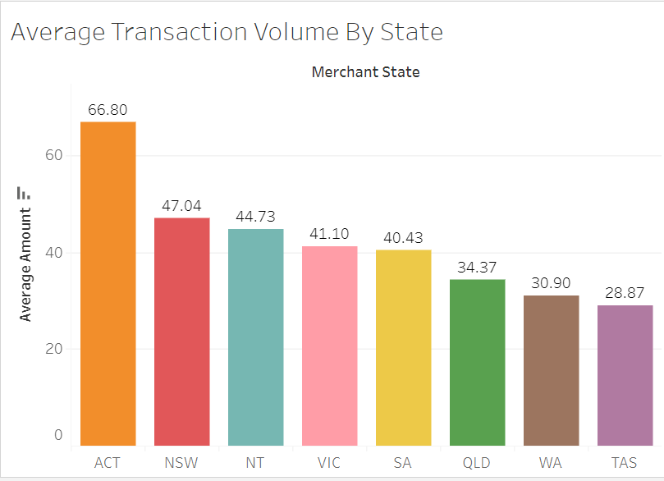
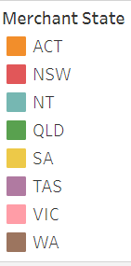
Data Insights
7. Insight About The Average Transaction Volume By State
These are the Average Transaction Volume By State
We can see , that ACT has the Highest Transaction Volume

Slide 21
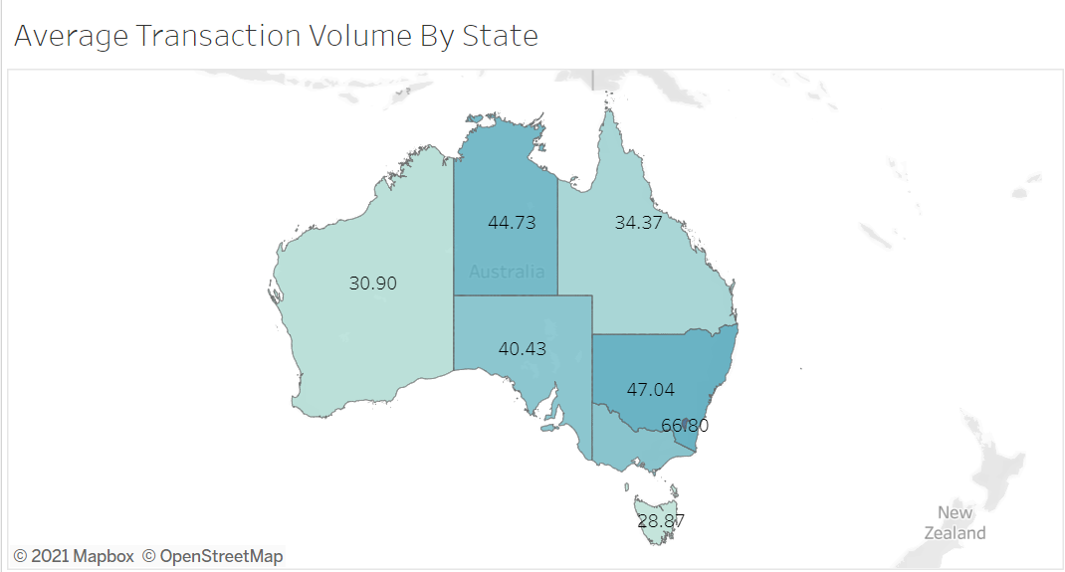
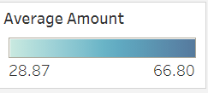
Data Insights
7. Insight About The Average Transaction Volume By State
Same Insight , shown in a Map Format

Slide 22
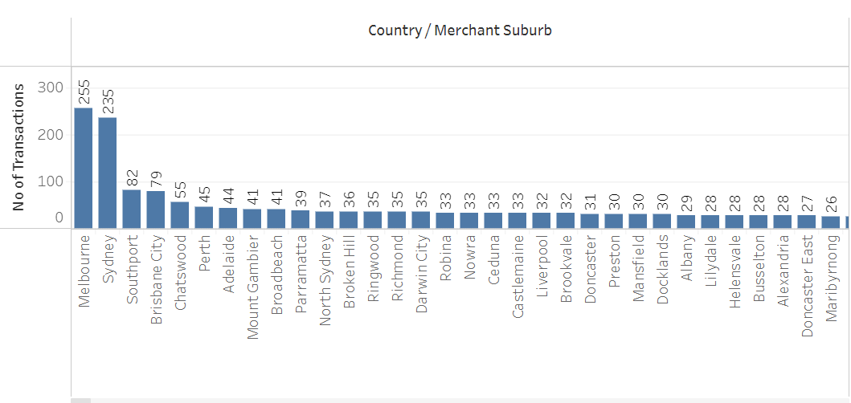
Data Insights
8. Insight About The Number of Transactions Per Suburb
We can see , that Melbourne and Sydney have the highest number of Transactions.
Considering that they are the main sub Regions in Australia , this analysis makes sense

Slide 23
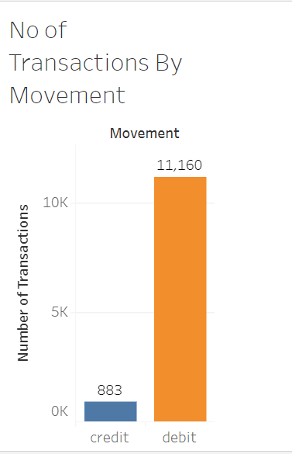

Data Insights
9. Insight About The Number of Transactions By Movement
These are the Number of Transactions By Movement (Credit and Debit)
We can see , that most of the transactions are debit transactions

Slide 24
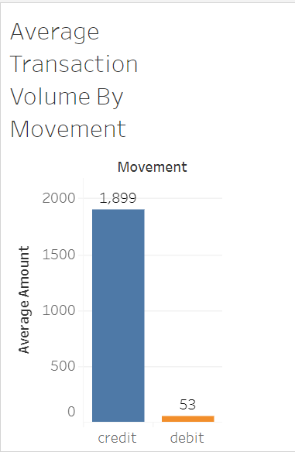
Data Insights
10. Insight About The Average Transaction Volume By Movement
These are the Average Transaction Volume By Movement (Credit and Debit)
We can see , average transaction amount that the for credit transactions are higher

Slide 25
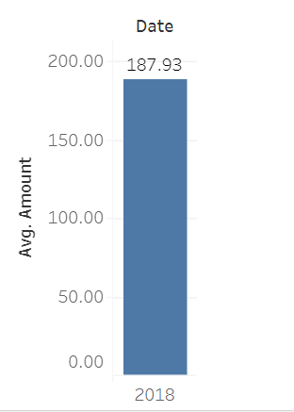
Data Insights
11. Insight About The Average Transaction Amount For the Year 2018
Average Amount For 2018 : 187.93 AUD

Slide 26
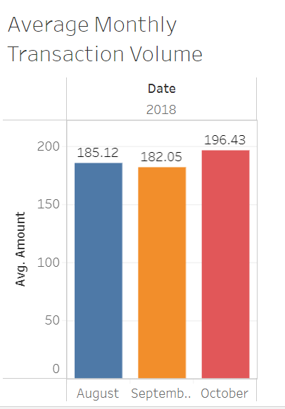
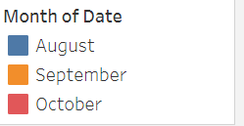
Data Insights
12. Insight About the Average Transaction Volume By Month
We can see , that the Average Transaction Volume is the Highest in October

Slide 27
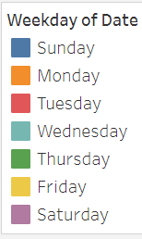
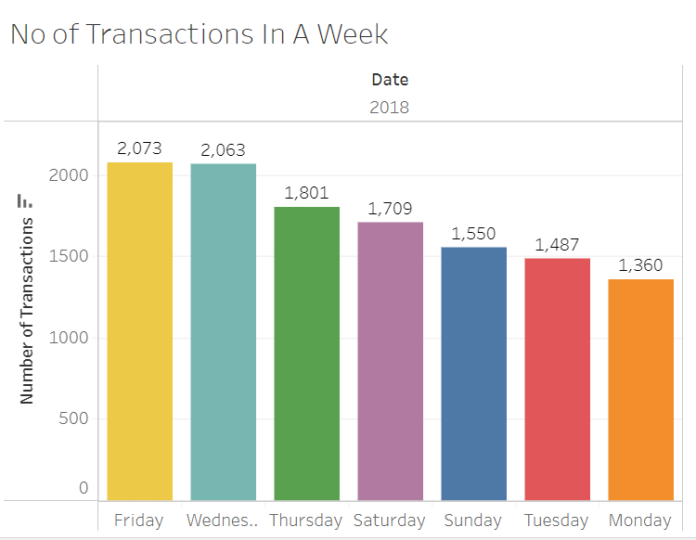
Data Insights
13. Insight About the Number of Transactions Within the Week
We can see , that the Number of Transactions are Higher on Friday and Wednesday
And the Lowest , on Monday and Tuesday

Slide 28
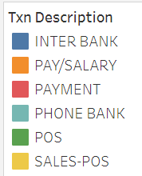
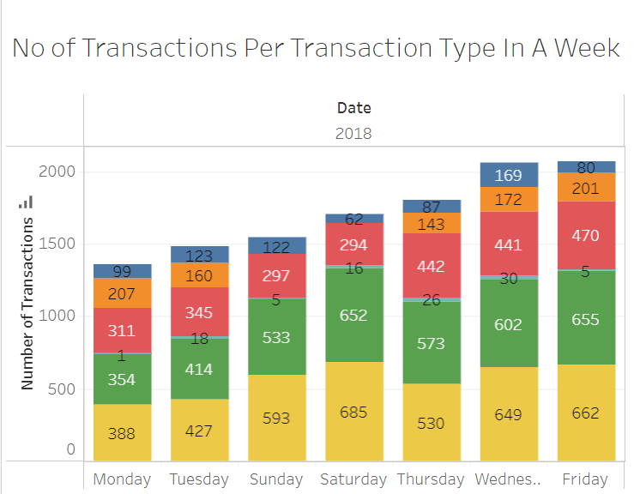
Data Insights
14. Insight About the Number of Transactions Per Transaction Type in a Week
We can see , No salaries were paid on Saturday and Sunday .
Sales-POS Transactions are the least on Monday and Tuesday

Slide 29
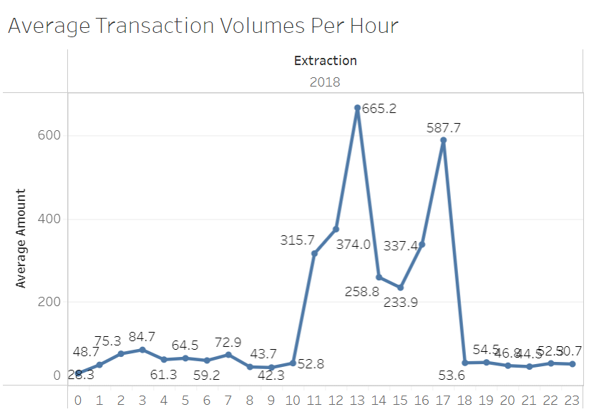
Data Insights
15. Insight About the Average Transaction Volume Per Hour
As we can see , the Highest Transaction Volumes happen during the mid-day and late afternoon.
Keep the IT Department of the Bank to maintain enough IT resources , so transactions can be smoothly conducted without any IT Breakdowns during that specific time.
Provide incentives to customers for doing transactions on other hours.

Slide 30
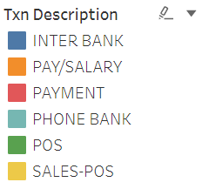
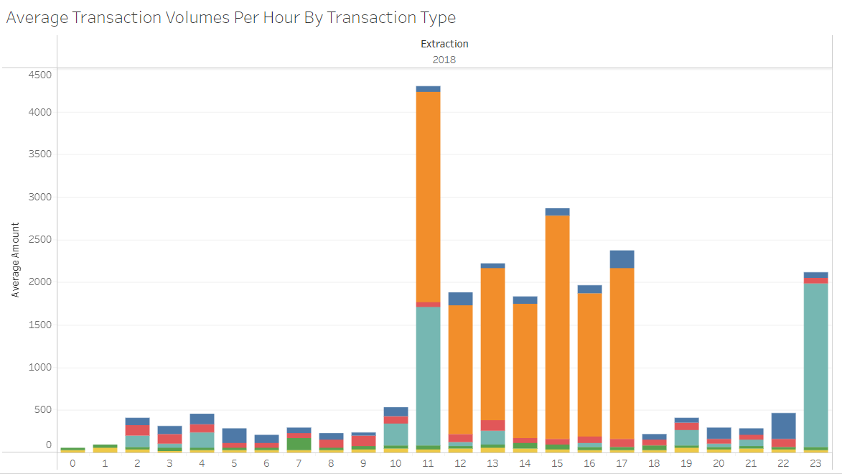
Data Insights
16. Insight About the Average Transaction Volume Per Hour By Transaction Type
As we can see , the Highest Transaction Volumes happen during the mid-day and late afternoon.
Pay/Salary Transactions majority happen during the mid-day and late afternoon

Slide 31
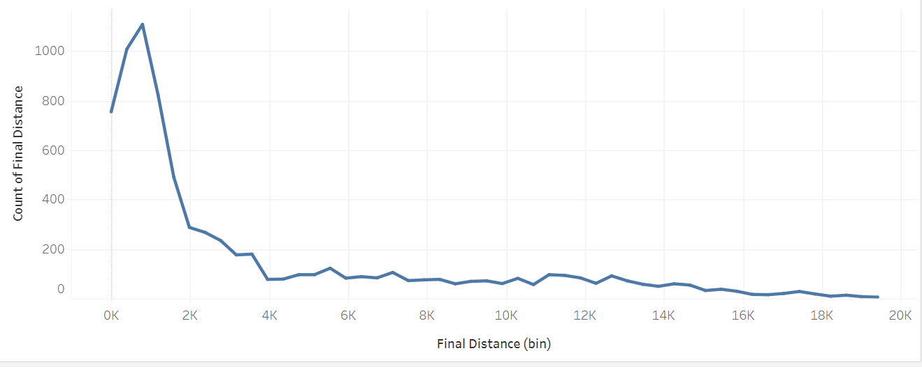
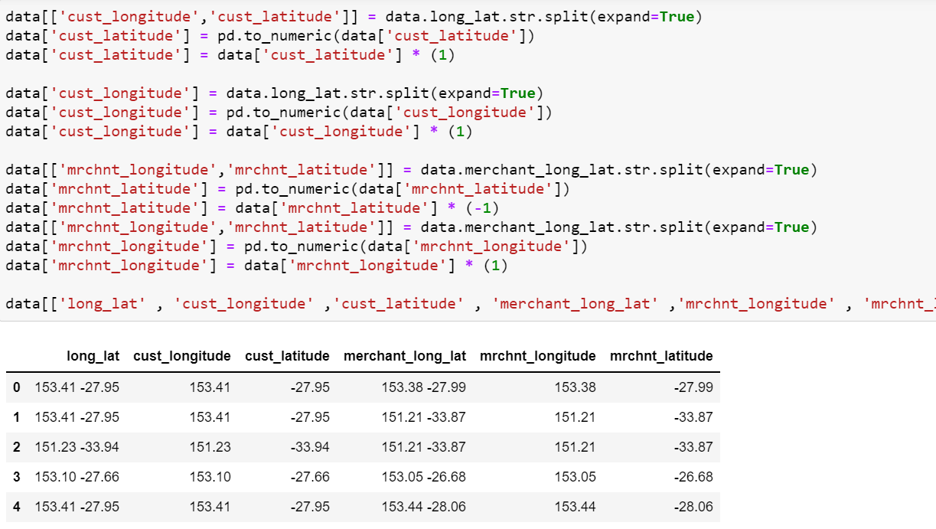
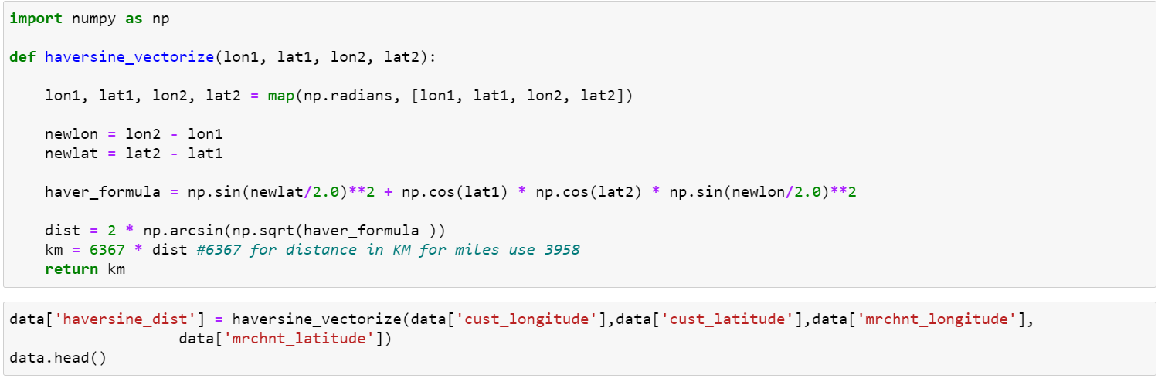
Data Insights
17. Distance Between the Customer and Merchant Location
We split the Longitudes and Latitudes of the Customer and Merchant
From the Analysis , we also found that there is one customer that does not reside in Australia
In Order to Calculate the Haversine Distance , we used the following haversine_vectorize function and got the distance in km.

Slide 32
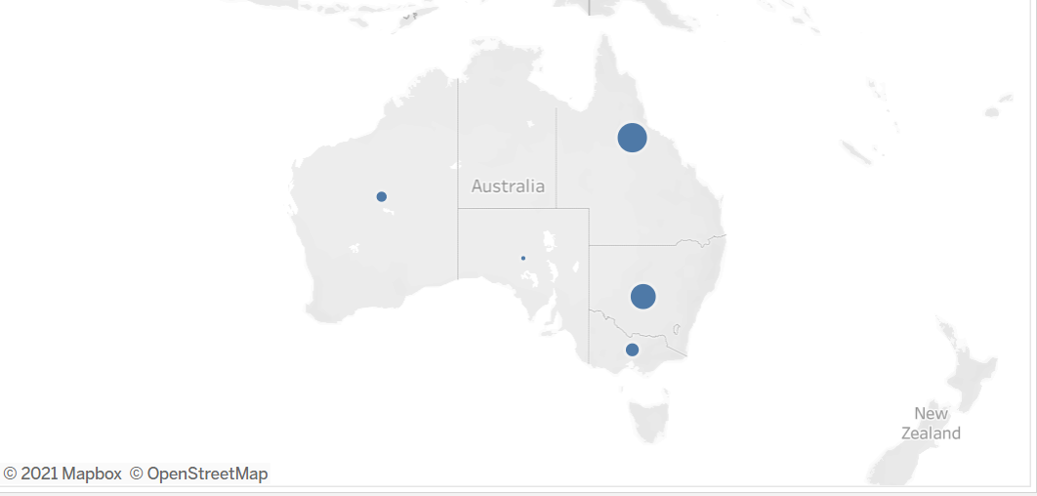
Data Insights
17. Distance Between the Customer and Merchant Location
For Customer ID CUS – 515066836 , the distance covered in QLD accounts for the greatest distance, and the least in SA.

Slide 33
Thank You!

